Slide 1
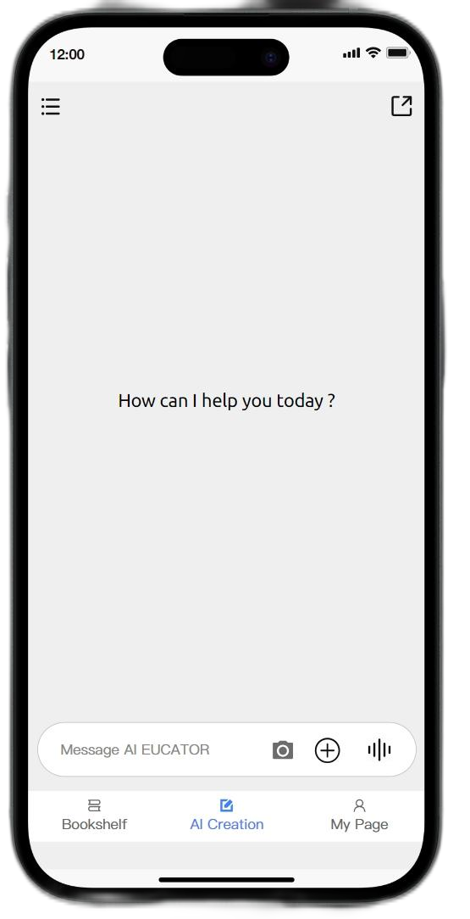
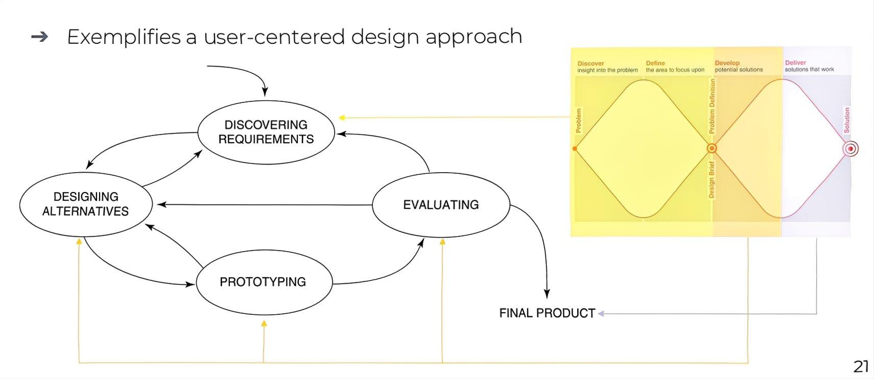






Introduction
AI
EDUCATOR
Topics (Generative AI in X ) :
The domain is English language education, specifically focusing on the teaching process of English reading comprehension in educational institutions.
Fig 1 Iteration Design LIfecycle model
Specific Problem and its importance:
English teachers often face the challenge of creating high - quality reading comprehension questions. Manually generating such questions is a time - consuming task. Teachers need to search for appropriate reading materials, design questions that test different cognitive levels, and ensure the questions are relevant to the curriculum and the students' proficiency levels. This process can be extremely labor - intensive [1].
Xu Chen 2257453
Group 43 Project Member :
Yongtai Li 2144072
Zichen Qiu 2252705
Sirui Zhang 1929648
a increasing workload
b birth rate growth
Mainly Contribution:
Requirement 2-4
Relation to Human - Centric Computing:
The project takes HCC as its methodological cornerstone, constructing a "tools as extensions" human-computer collaboration through the path of "explicit identification of user needs → cognitive alignment of interaction design → value-added empowerment through technology".
Evaluation 1-2
Requirement1
Prototyping1-4
Evaluation 3-4
Questioniare
Interviews
c keep up with the trend

Slide 2

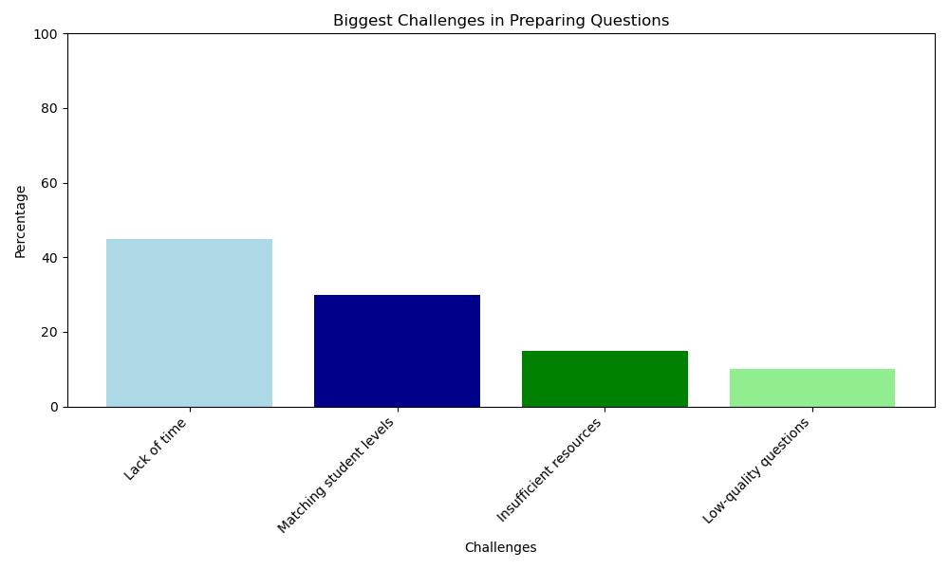
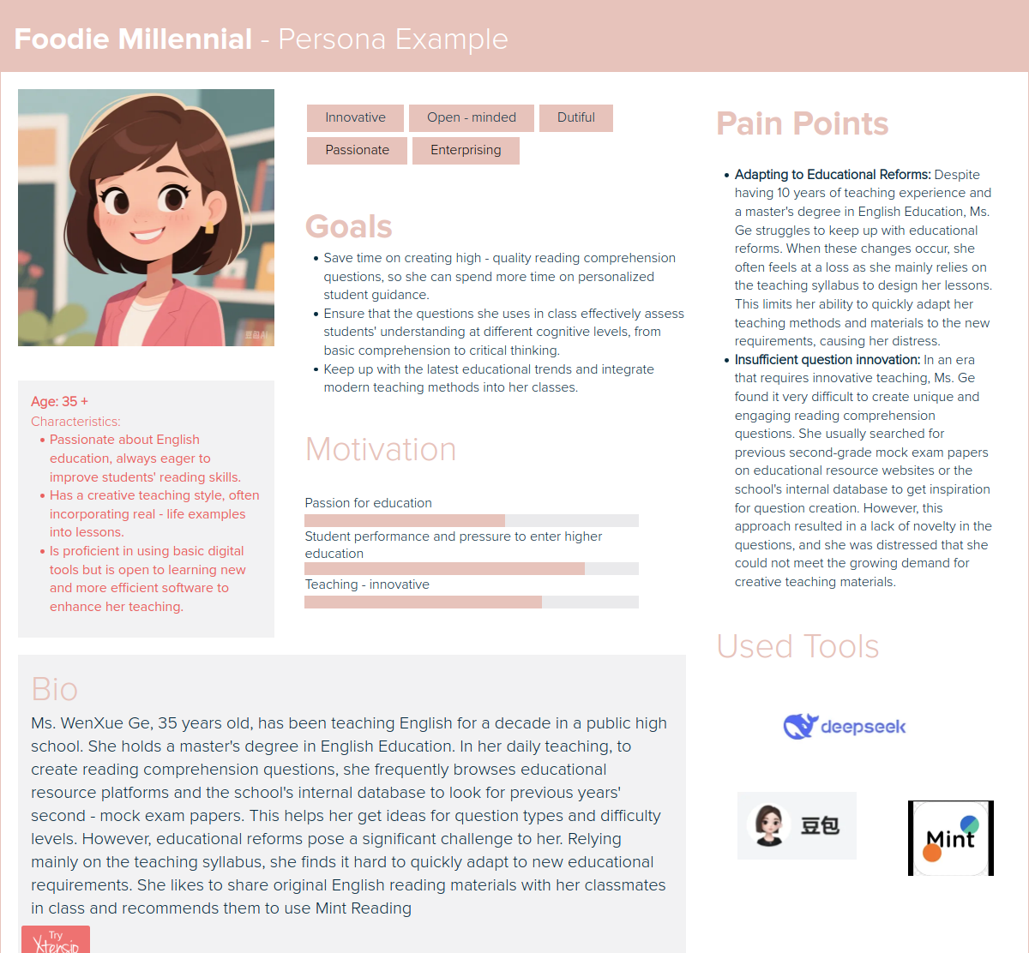

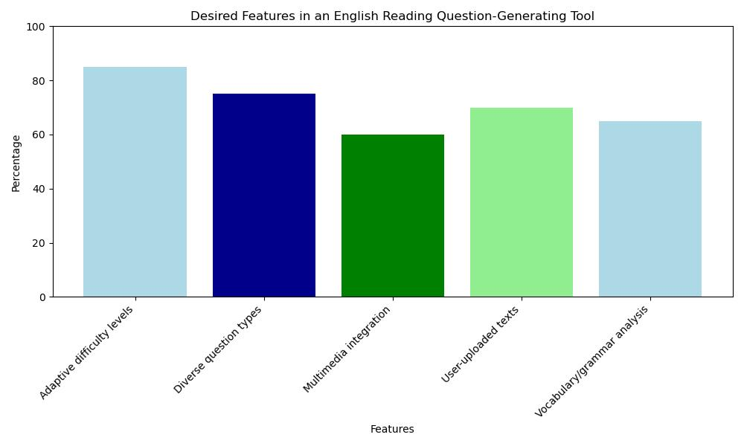




Initial User Requirements
Evidence
User group characteristics
We distributed Questionnaire to 30 English teachers. Most teachers believed the existing question - creation resources were time - consuming. (Fig 3)
When asked about the functions they most expected from a question creation software, they mainly chose the ability to set different difficulty levels and various question types.(Fig 4)
High level of education
Teaching needs-driven
Pay attention to student feedback
Different levels of acceptance of technology
Fig 3 Challenges in Prepareing Questions
Type of requirements
Fig 2 Persona About Wenxue Ge
Our findings are consistent with the viewpoints in the research paper [2]. This paper points out that the traditional method of manually creating reading comprehension questions is time - consuming and labor - intensive.
Content requirements
Functional requirements
Interface requirements
English reading materials
Different topics
Different difficulty levels
Personalized questions Question analysis
Hitory records
Score statistics
Easy-to-use interface
Reading materials and questions are clearly displayed
Fig 4 Desired Tools in AI Educator

Slide 3





Design Principles
log in with check
Support voice input
Constraints
Accessibility
Visual consistency
Interactive feedback
Gray as main color
Continuously improve user needs

Slide 4

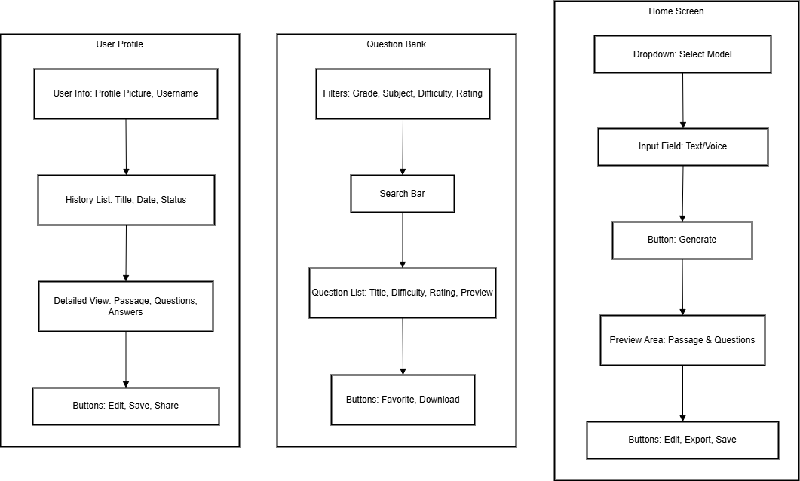
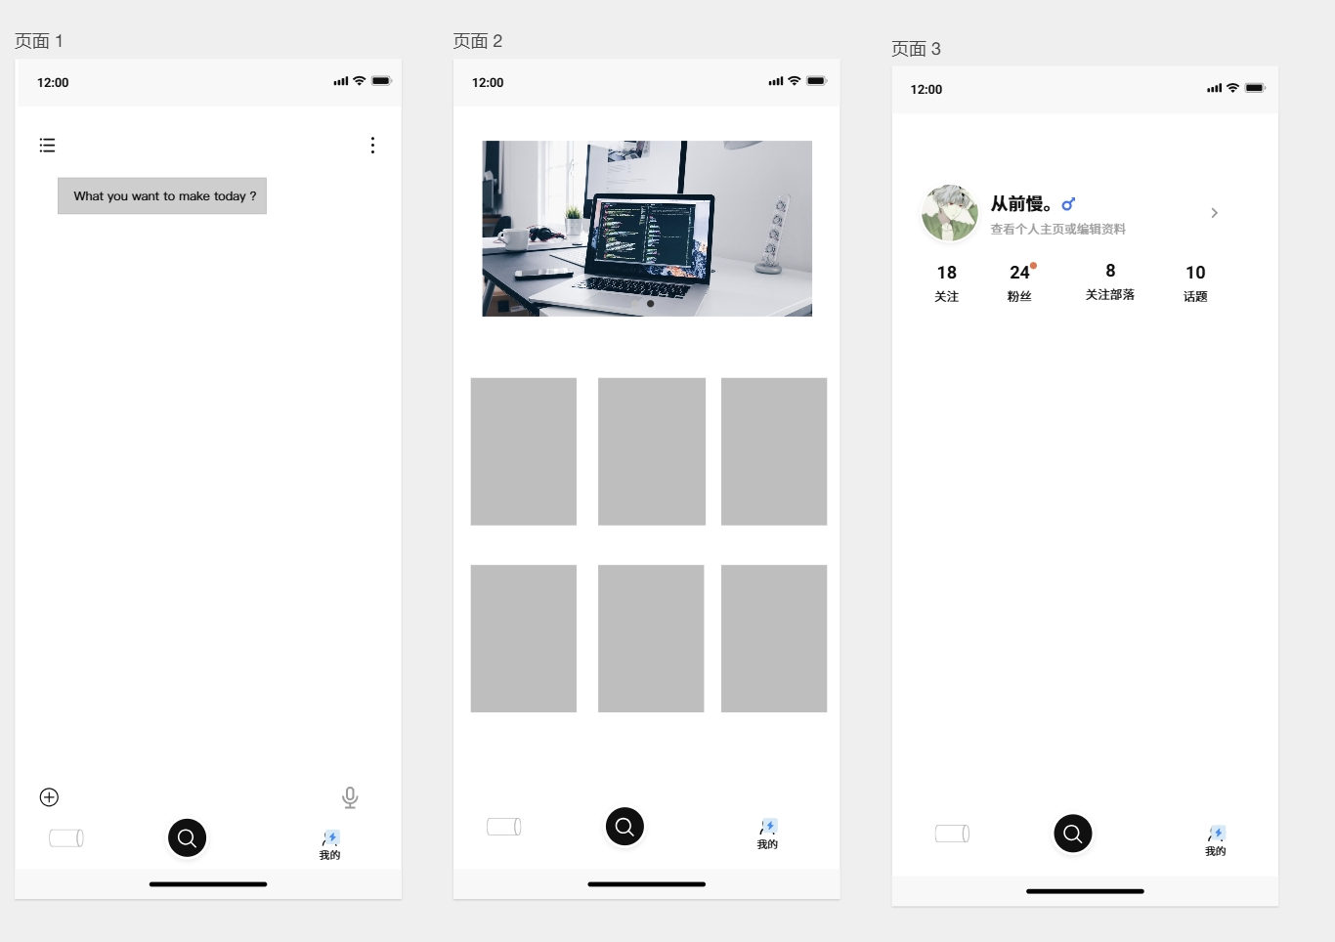

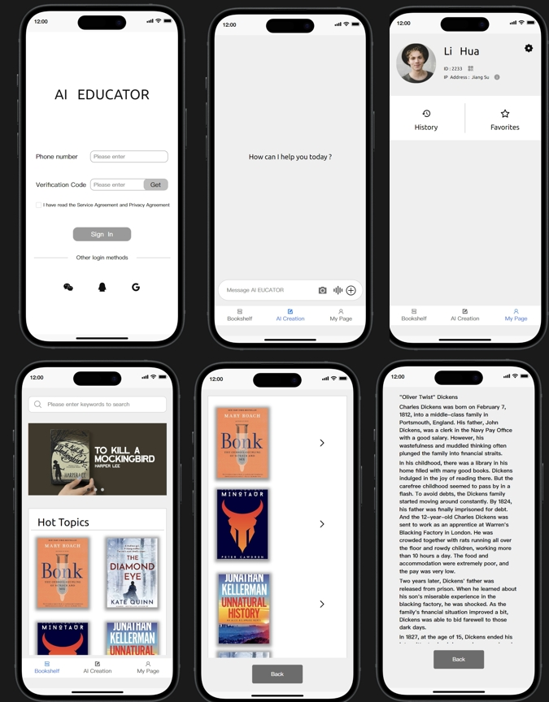
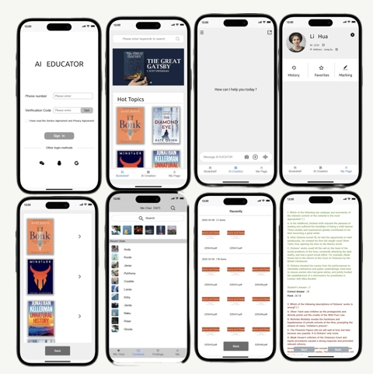
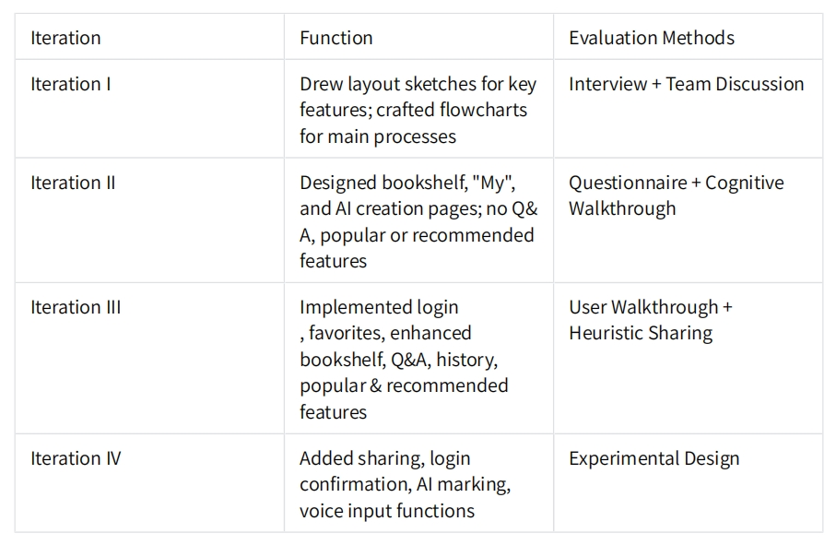
Prototyping
Trade -off
Functional completeness and development difficulty :
Original Plan: Use complex algorithms to set questions accurately, considering multi-dimensional data
Prototype stage Adjustment: set questions only based on the word count of reading materials and question types
Interface Design and User Experience :
Design Approach: Adopt a mature interface layout mode to speed up the design process.​
Visuals and Operation: lack novelty to help users quickly get familiar with the operation process.​
Interaction Effects: Retain basic interactive effects while omitting complex animation effects.
Menu Design​
Retain only the first - level menu at the bottom of the brief introduction.​
Tools and Compatibility​
Use the Modao tool for prototype design.​
Compatible with both iOS and Android systems.​
Function Breadth​
Implement both the generation and marking functions.​
Function Depth​
Do not support listening, speaking, and writing functions currently.​
Fig 6 Iteration 1 of the prototype
Fig 7 Iteration 2 of the prototype
Fig 9 Iteration 4 of the prototype
Fig 5 Four iterations comparison
Fig 8 Iteration 3 of the prototype

Slide 5



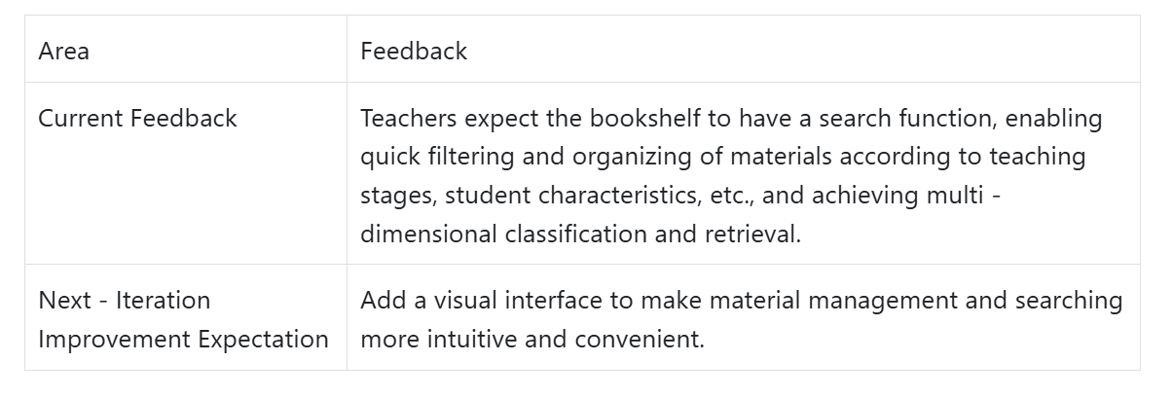

Iteration 1
My contribution: Writing prototypes and participating in group interviews and evaluations
Evaluation (Interviews) :
Interview Process​
Task Explanation: Provide high school English teachers with detailed information about the evaluation task to assess the flowchart in the sketch.​
Independent Review: Give teachers sufficient time to review the flowchart design alone.​
Questioning Session:
How does the user management page distinguish users with different permissions?
Can the bookshelf function classify and organize materials according to students' learning progress?
Does the operation of the creation page meet the needs of the teaching scene?
Discussion and Analysis​
Analysis Dimensions: Analyze from multiple dimensions, including actual teaching needs, user operation convenience, and product implementation feasibility.​
Final Conclusions​
Determination of Important Pages: Confirm that the three interactive pages of user management, bookshelf, and creation are indispensable and crucial parts of the product.​
User issues :
Unclear operation process of the tool
Doubts about the technical implementation method
Key Insights
Prototyping Reasons :
Quickly present the core concepts
Reduce the cost of trial and error
Focus on user needs

Slide 6
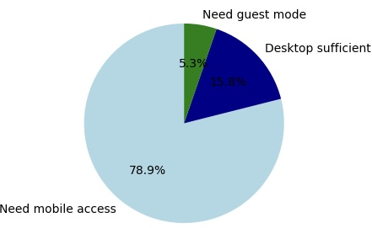
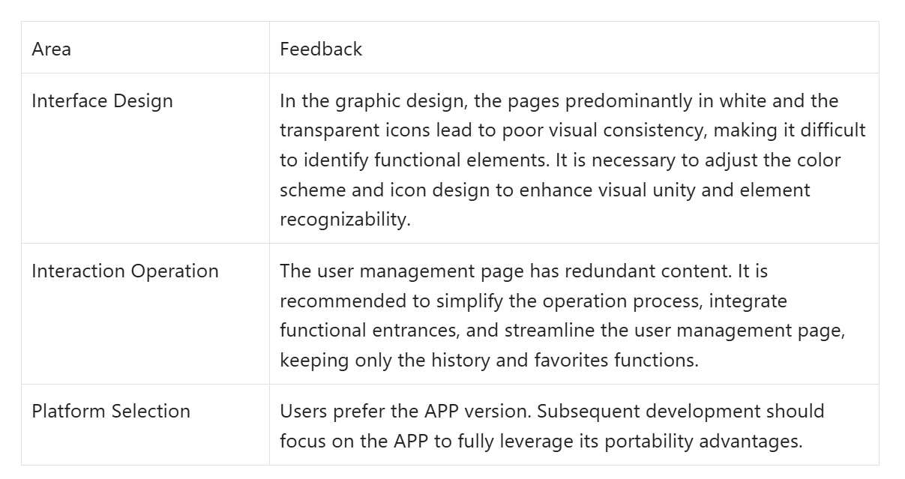
Iteration 2
My contribution: Writing prototypes , Drawing up a questionnaire and visualize the received data.
Evaluation (Questionnaire + Cognitive Walkthrough ) :
User issues :
Difficulty in intuitively understanding the actual user experience just from the flowchart
Flowchart Architecture Limitations​
Ambiguity regarding whether to target computers or mobile phones.
Software Feedback
Questionnaire
Survey Basics​
Sample Size: 30 samples were selected for the questionnaire survey.​
Survey Content​
Focused on collecting users' preferences for product usage platforms (APP or Web) through carefully designed questions.​
Survey Results​
The results clearly indicated that users prefer to use the APP side.​
Fig 10 Software Feedback
Cognitive Walkthrough Identified Issues​
Visual Design Issues​
The page predominantly uses white as the color, and transparent icons are difficult to locate, resulting in poor visual consistency.​
Functional Design Issues​
The user management page contains excessive content. As it is not a social media application, only historical records and a collection function are required.​
Prototyping Reasons :
Graphic design intuitively displays divergent user thinking
Subjectively believe that mobile apps are more suitable for teachers to use interactively
Key Insights

Slide 7
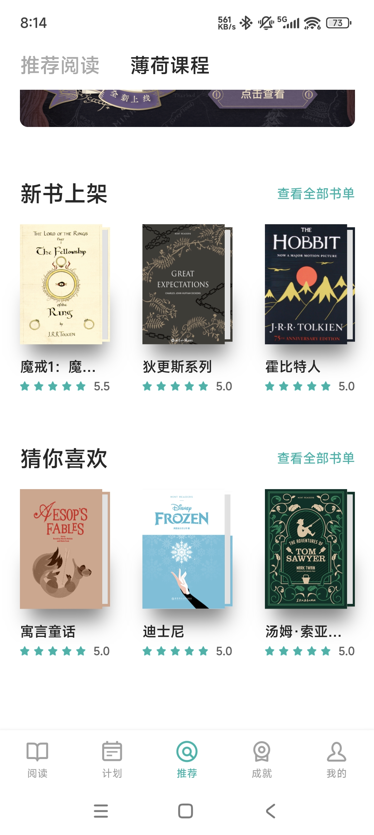
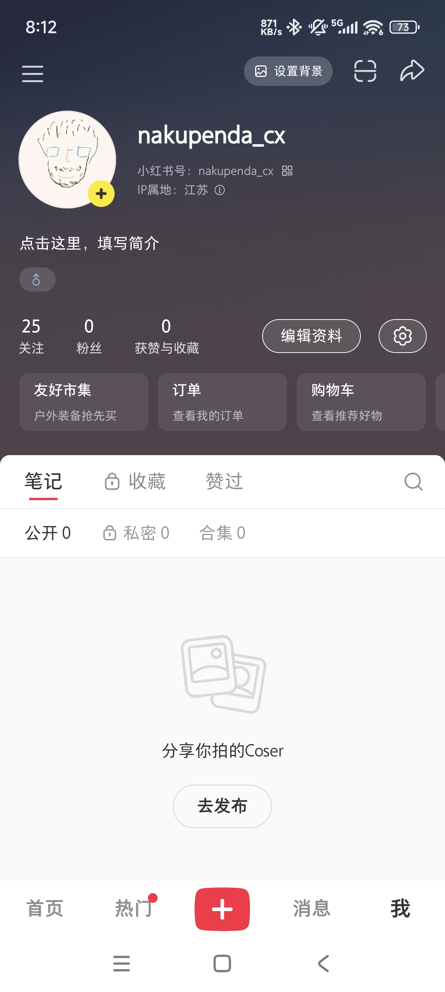
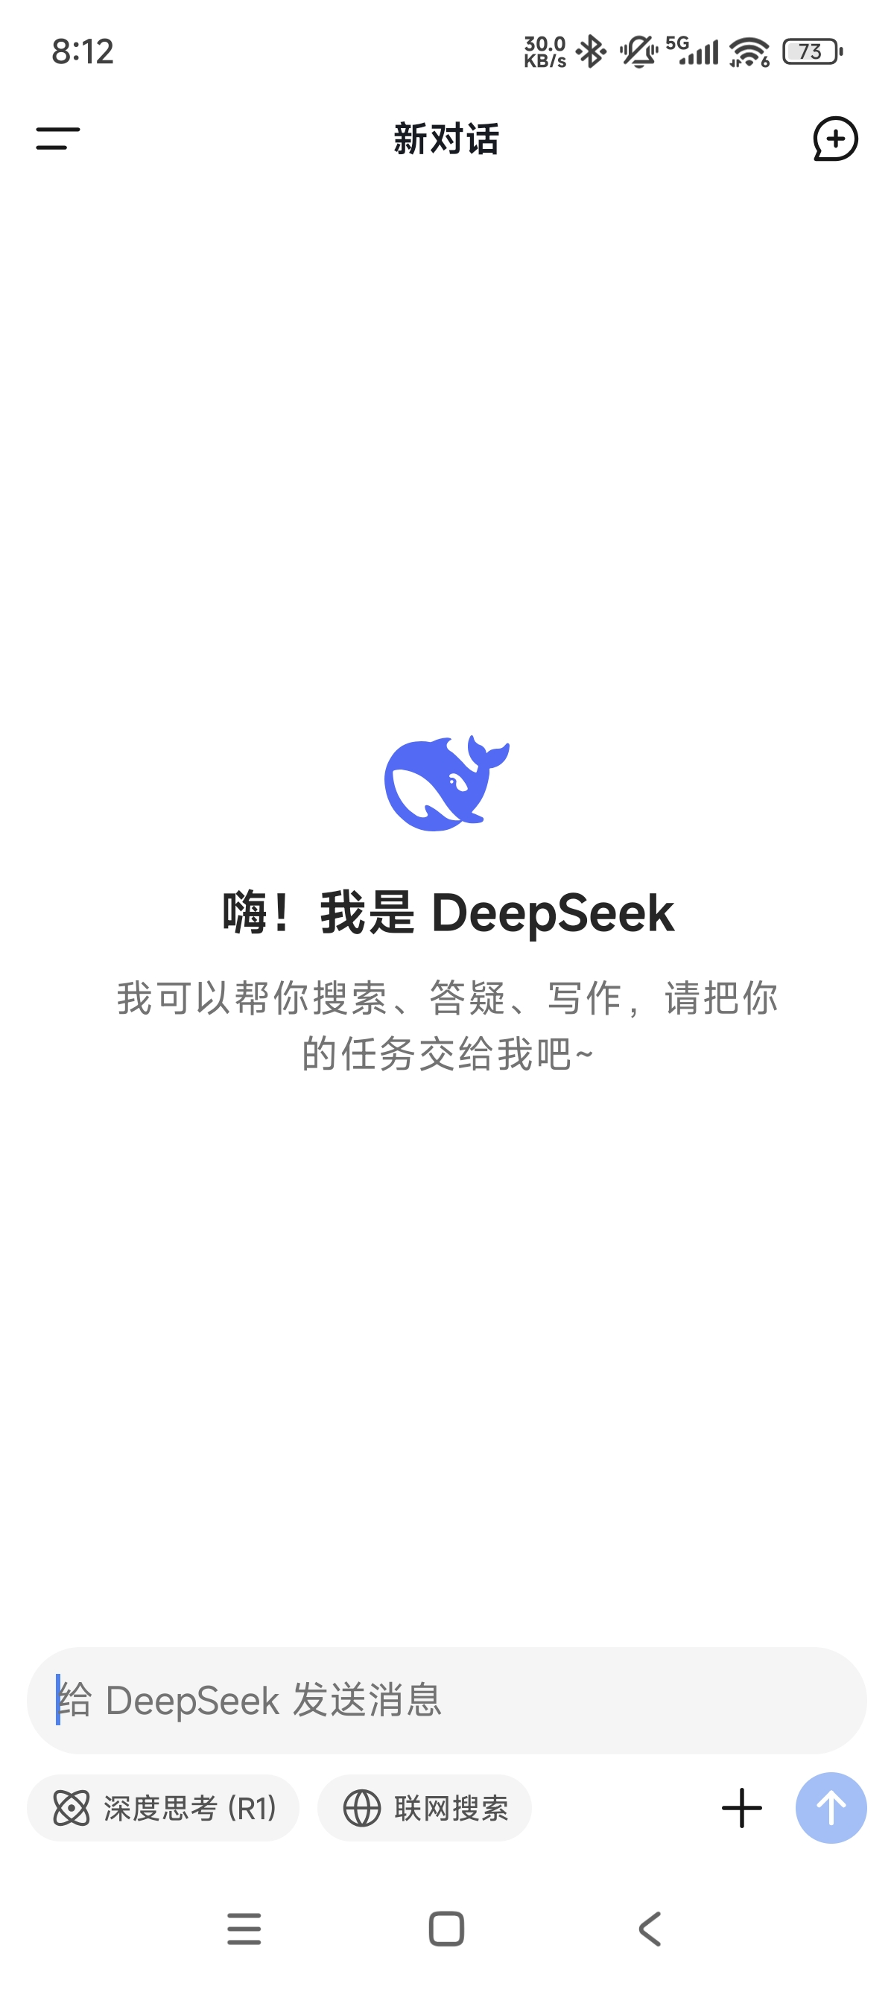
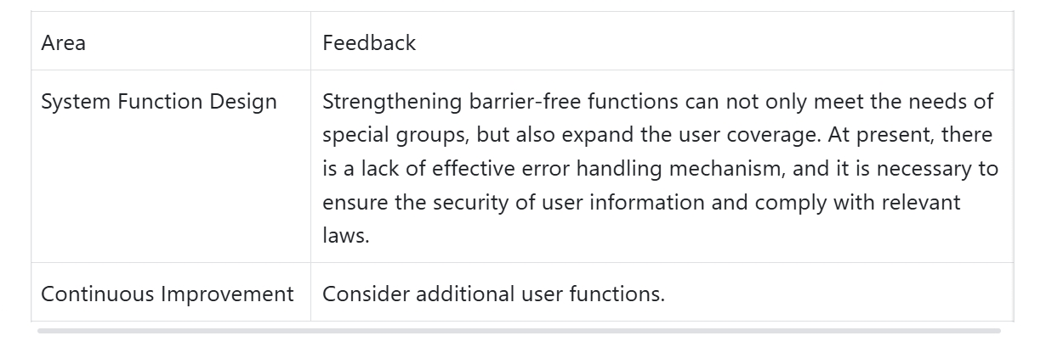
Iteration 3
My contribution: Writing prototypes and Do heuristic analysis.
Evaluation (Heuristic analysis
+ User Walkthrough ) :
User issues :
The difficulty that users can perceive, understand, and discover for interactive interface icons
Heuristic analysis
Languages familiar to users
A one-click option to return to the creation interface
The overall visual style is simple and consistent.
Shortcomings : Firstly, an effective error handling mechanism is lacking. Secondly, the accessibility is suboptimal. The needs of special user groups (such as people with disabilities) have not been fully considered.
User Walkthrough
Task​ : Write an article you like and obtain an article of interest from the bookshelf.​
Search Function Usage Issues: When using the search function to find learning materials, some users repeatedly tried different keywords due to the absence of expected results.
User Feedback​ : Users generally reported that they occasionally operated other function buttons by mistake during the creation process and hoped for clearer operation prompts.​
Prototyping Reasons :
Refer to the bookshelf interface of Mint Reading, the creation interface of Deepseek, and the user management interface of Xiaohongshu to ensure that using books is simple and easy
Realize user interaction to facilitate user perception and subsequent simulation evaluation testing
Key Insights

Slide 8
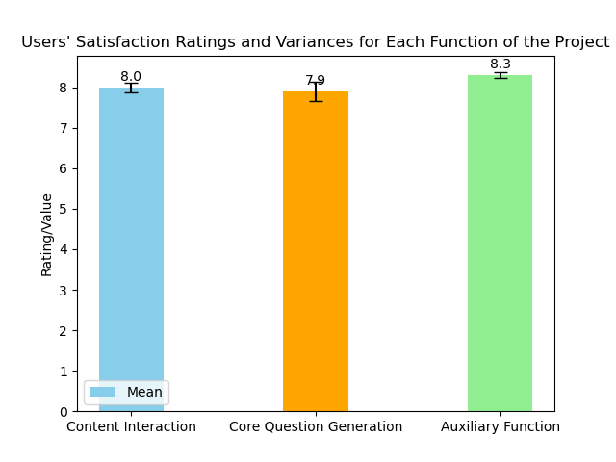
Iteration 4
My contribution: Writing prototypes and independently complete experiments, data collection, analysis and evaluation.
Evaluation (Experimental design) :
User issues :
Function Operation Difficulties
Users could be unfamiliar with uploading answers for the whole class when using the homework - correction function.
Time Management Difficulties
Users may struggle to balance the time spent on different product functions. Teachers might still find it hard to reduce time wasted on repetitive and tedious tasks, preventing them from fully focusing on core teaching activities.
Difficulties in Adapting to the Closed - loop Function
Users could be confused about how to utilize product functions to achieve effective closed - loop operations in homework management and teaching feedback, or experience inconvenience when switching between different links.
Difficulties in Meeting Personalized Needs
Given the diverse learning characteristics and requirements of different students, the product may fail to fully adapt to these varied needs, which in turn impacts students' learning outcomes and teachers' teaching results.
Purpose : Use F test to analyze user satisfaction with the project. Experimental hypothesis : Users are basically satisfied with the project.
Sample : 30 users from 4 different schools between 25 and 55 years old Experimental process :
Users sign a consent form to clarify the data collection and use methods involved in the experiment.
Users conduct a 10-minute unguided experience to freely explore the various functions of the project and simulate real-life usage scenarios.
After the unguided experience, provide users with a video presentation to introduce some key functions and users continue to experience the project for 10 minutes to further familiarize themselves with the functions .
Users rate the content interaction, core questions, and auxiliary functions of the project on a scale of 0-10, with 0 indicating very dissatisfied and 10 indicating very satisfied.
Prototyping Reasons :
AI grading reduces the burden of writing feedback for teachers, allowing teachers to spend more time on teaching design and student tutoring.
Through sharing, users can communicate and discuss with each other, enhancing user interaction.
The login verification mechanism maintains the user's right to know and complies with local laws.
Fig 11 Uses’ Satisfaction Rate
Results :
The experimental results show that the mean score of each function is around 8, and the variance is very small.
This shows that users are generally satisfied with the project, and the evaluations among users are relatively consistent.

Slide 9
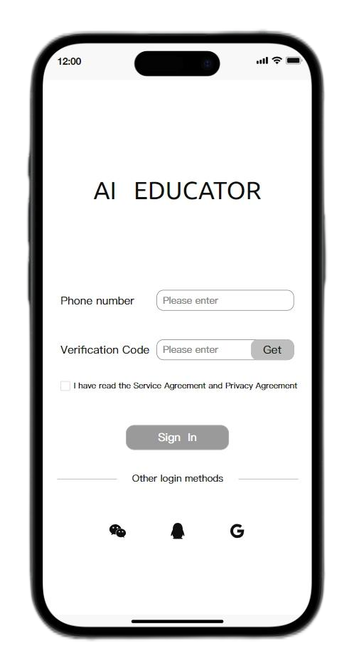
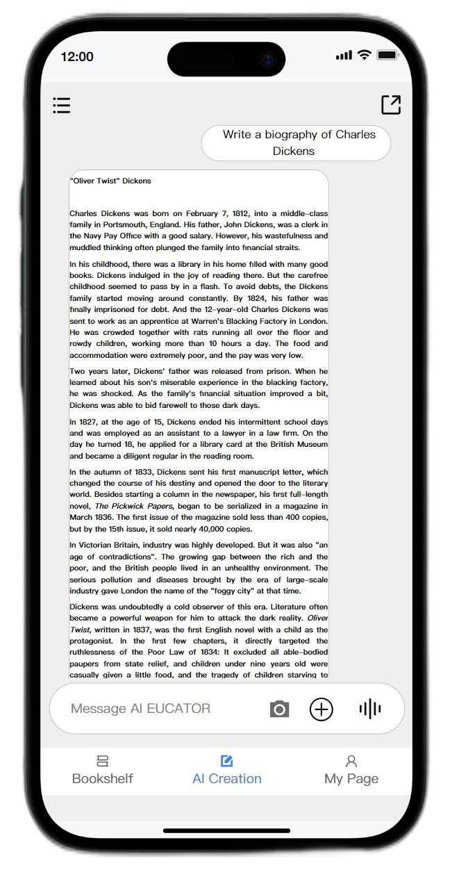
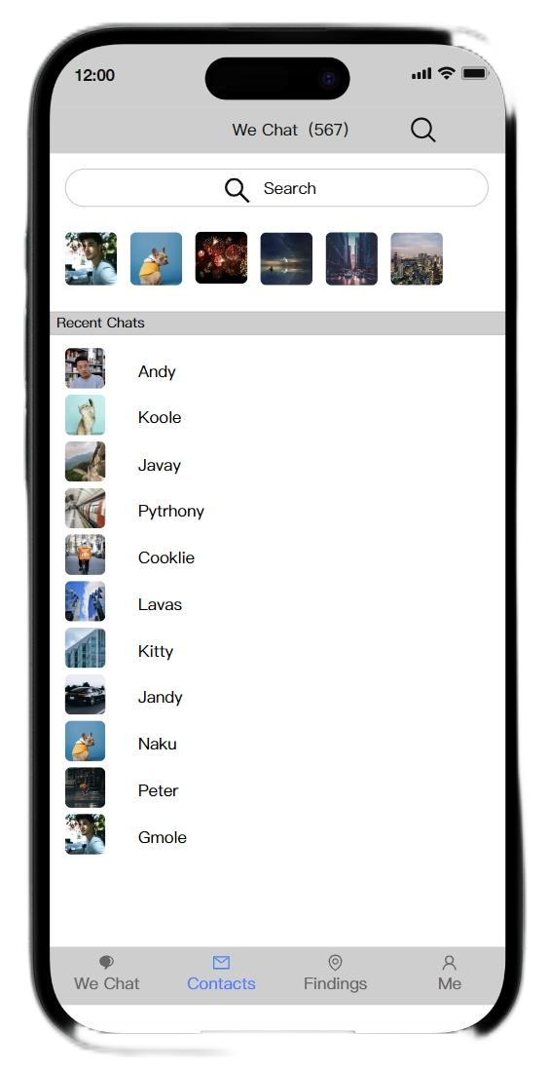

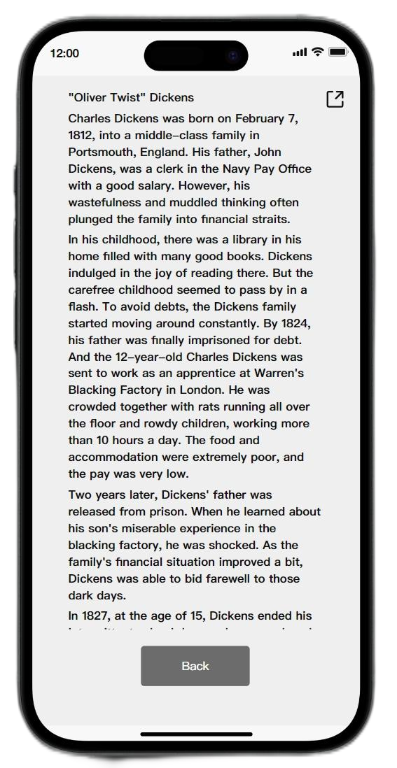

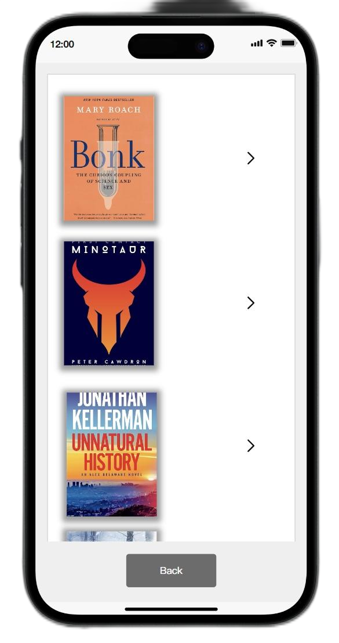

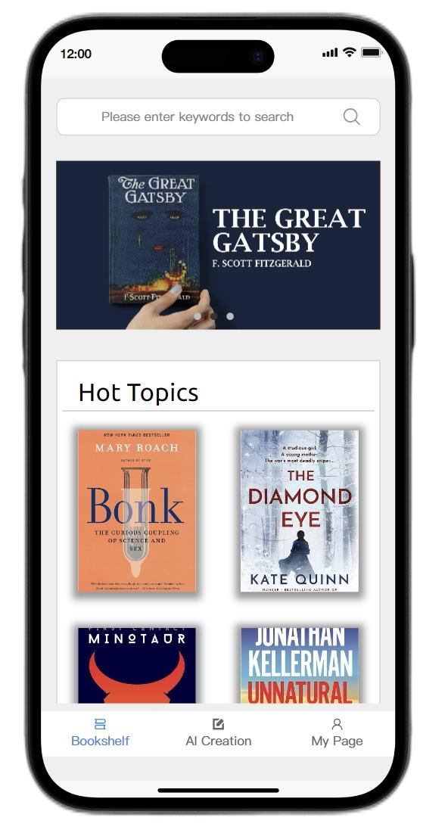
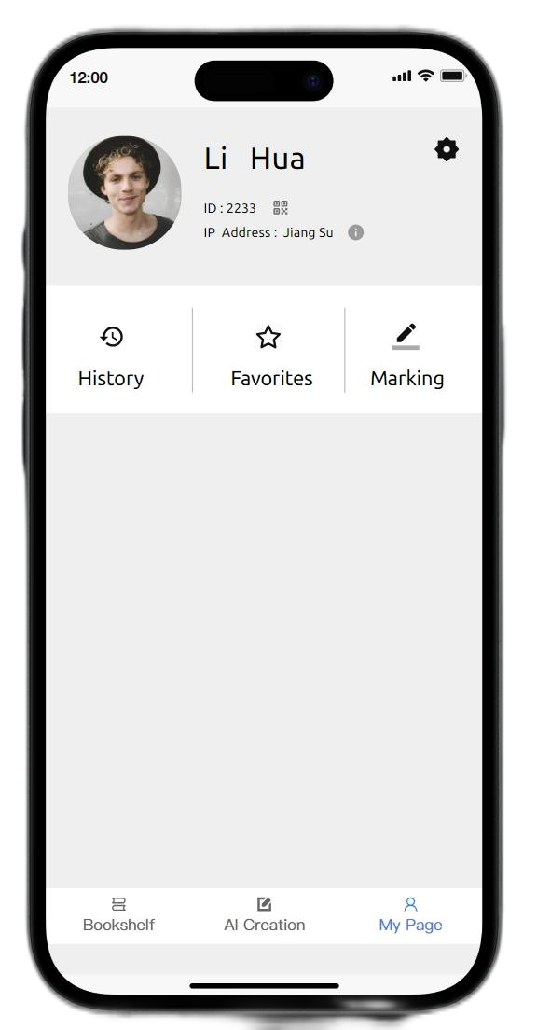
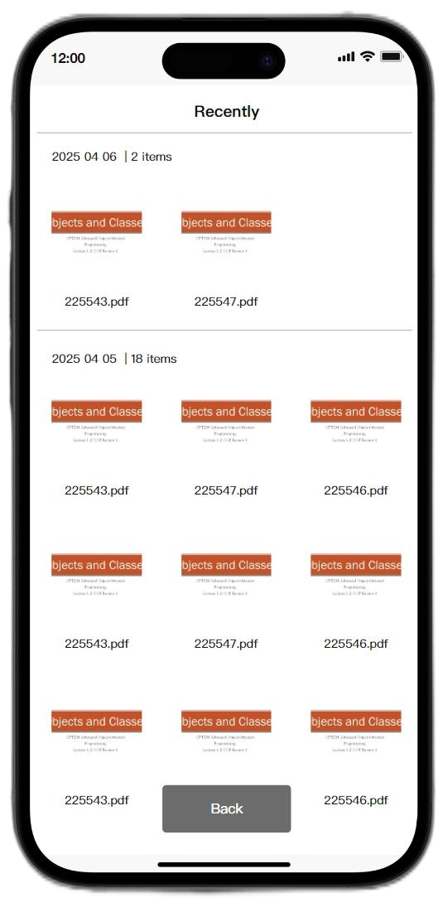
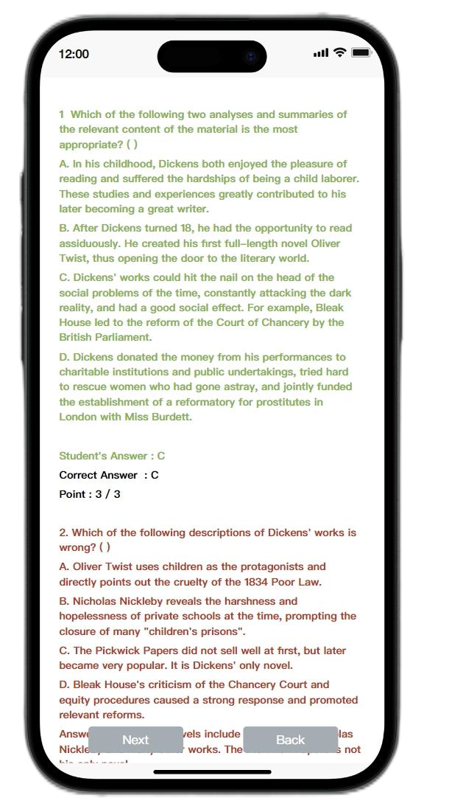
Iteration 4 Showcase
Enter text in the dialog box to create English reading
Click Login from the login interface to enter the creation interface
Click Share to jump to the WeChat interface and share with friends
Click on the bookshelf and my page in the navigation bar to jump
Click History/ Collection/Content Search to jump to the topic you want to view
Click on the rating to jump to the interface for reviewing and correcting files. Click on any document for automatic rating.

Slide 10

Conclusions
Our app now offers essential features such as secure login, a functional bookshelf, and basic content generation. These features have provided users with a starting point for efficient study and content management, addressing initial user needs like access control and resource organization.
However, the question - answering module's accuracy remains inconsistent, often providing subpar answers. The customization options, though present, lack finesse in truly tailoring to diverse user preferences. Also, the app's performance can be sluggish, especially when handling large reading materials.
In the future, we aim to enhance the question and use deepseek api to realize a true prototype.
References
Day, R. R., & Park, J. S. (2005). Developing Reading Comprehension Questions. Reading in a foreign language, 17(1), 60-73.
Ghaffarian Asl, S., & Osam, N. (2021). A study of teacher performance in English for academic purposes course: Evaluating efficiency. Sage Open, 11(4), 21582440211050386.

